Slide 1

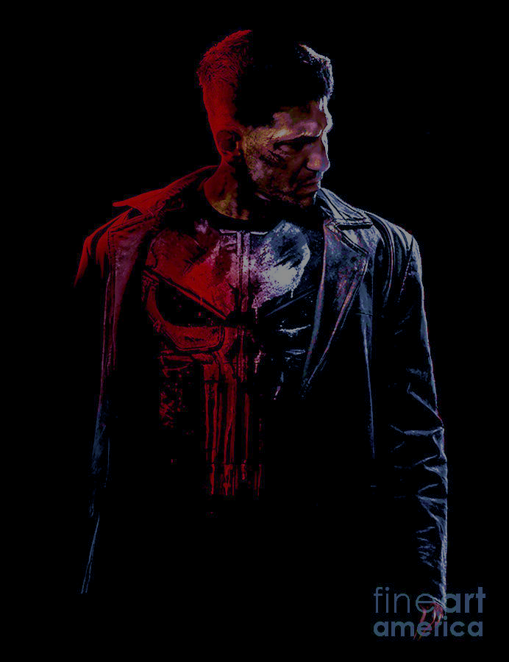
A product for the Punisher
Riley Mitchell

Slide 2
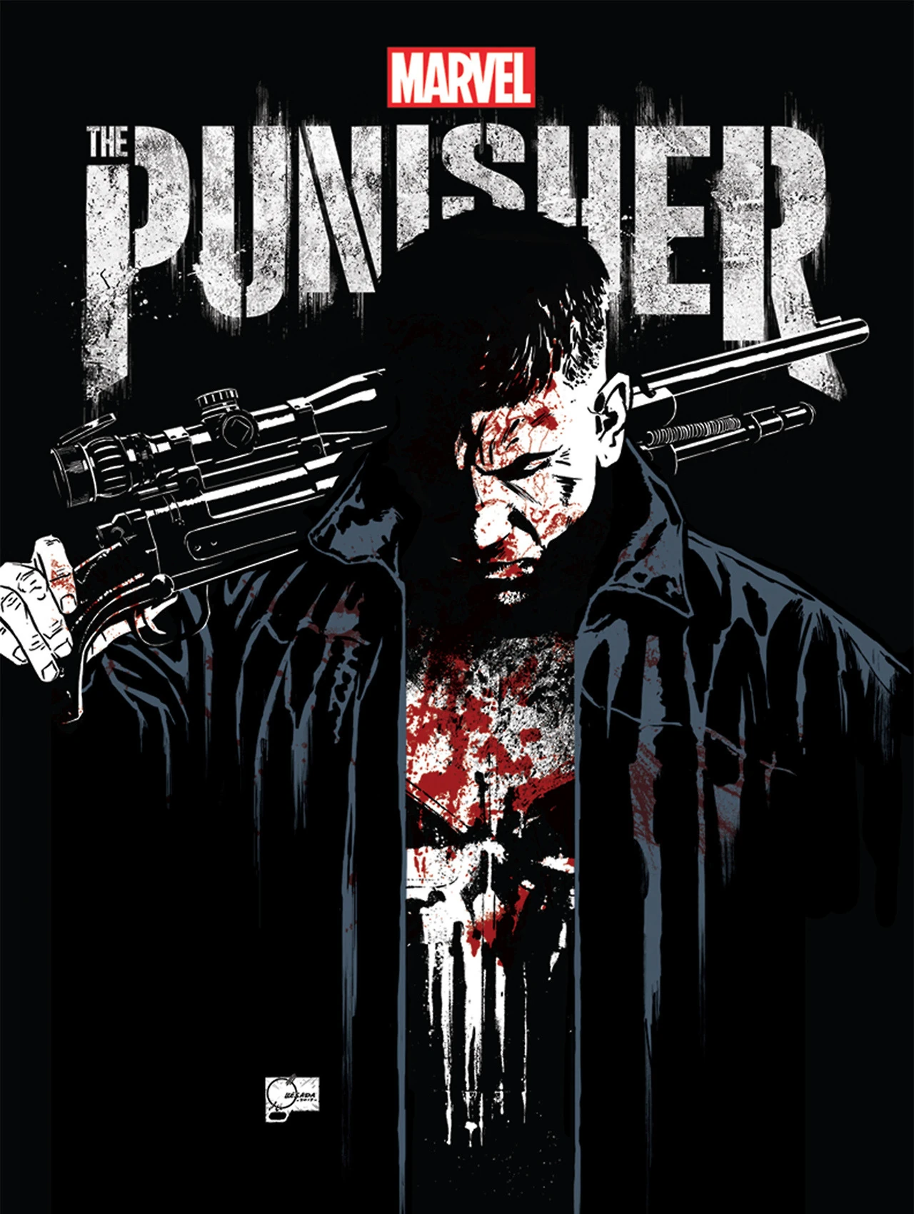
Who is the punisher?
The Punisher is a character in the Marvel Cinematic universe
a former Marine and Vietnam War veteran who is highly skilled in hand-to-hand combat
takes on the persona of the Punisher, a vigilante who uses brutal force to enforce his own brand of justice
Does so after he concludes that NYC law enforcement failed him and is run by corrupt cops
A firm belief that the armed forces are one of the few things capable of maintaining law and order
He is commonly considered an anti-hero because he intends to ensure all criminals receive the justice they deserve, however tends to be reckless in doing so

Slide 3
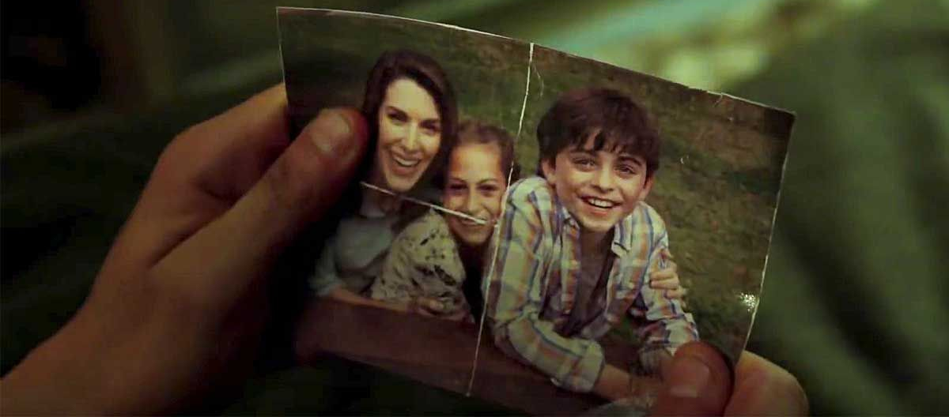
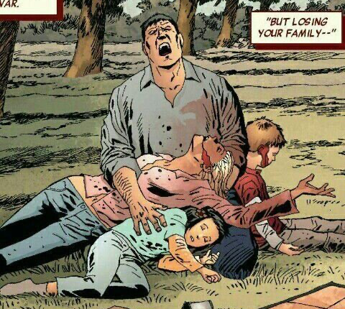
His real name is Frank Castles, and he was a friendly family man, who turned into a cold and careless crime-fighting vigilante
His life took a dark turn when his wife and children were tragically killed in a mob shootout while they were having a picnic in Central Park
that event served as the catalyst of his transformation into the Punisher, as he vowed to avenge the death of his family
During the process, he uncovers a shady conspiracy about a criminal underworld and continues to embody his alter ego with the goal of cleaning up the streets of New York City
His appeal lies in the blurred line between him being a hero or an antihero, as well as the consequences he endures because of his vigilantism

Slide 4
His weaknesses:
Emotional trauma- easily destabilized by the traumatic loss of his family
Strict moral code- prevents him from killing i= nocent people and can be exploited by enemies or cause him to act erratic if code is altered
The lack of superhuman abilities- makes him vulnerable in confrontations with superpowered opponents
Vigilante reputation- operates outside the law and is frequently pursued by law enforcement; makes it difficult to gain allies and public support; enemies can target him easily
Isolation- often works alone, lacks support in dangerous situations
Mortality- constantly put into positions where he is subject to death and injuries; as well as the physical limitations of aging
Resource limitations- relies entirely on military skills, weaponry, and hand-to-hand combat

Slide 5
His strengths:
Military experience- taught him to have an incredibly accurate shot with a variety of weapons, expertly skilled in most forms of combat (hand-to-hand combat, mixed martial arts, boxing, etc.), skilled in tactical planning, received thorough survival training and special operation skills
Vast arsenal- has access to a larger selection of weapons, gadgets, devices, and military-grade equipment
Resilience- has an unwavering sense of determination and willpower; reflected in his commitment and follow-through on missions
Intelligence- has an extremely high IQ with the ability to learn and excel at new things quickly

Slide 6
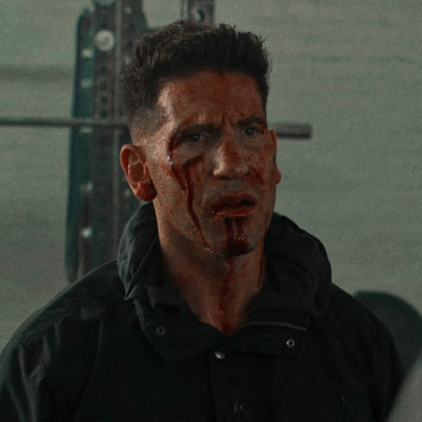
What is his problem?
After evaluating the punisher’s weaknesses and how they coincide with his strengths, it is clear that the main reoccurring problem that he faces is the fact that he is constantly putting himself into dangerous life-threatening unpredictable situations that test his mortality
vulnerable to being injured
limited amount of endurance
At a constant risk of fatality
Lacks superhuman abilities
always depicted covered in scars, blood, dirt

Slide 7
Product goal
The goal of the product for the Punisher is to help aide him in keeping his mortality intact, while also assisting in suppressing the impacts of his weaknesses and amplifying his strengths

Slide 8
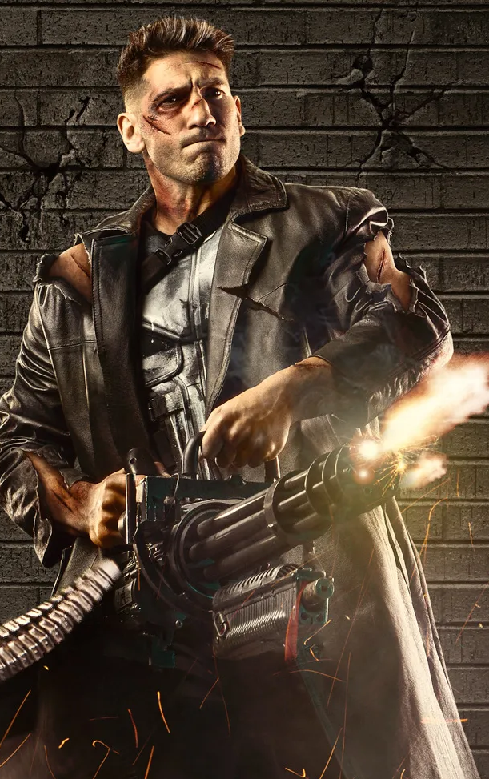
important design factors to be included
The product is on brand and realistic for him to include it in his everyday life without creating a new additional task
The product reflects his chosen dark and simplistic aesthetic
Can be placed and accessed somewhere safe and secure on his person, taking his more than frequent active state into consideration
Can complete each viable task automatically and/or manually
Lightweight, breathable, and non-constrictive
Have extra compartments for practical storage
Look discreet and unsuspecting to the enemy in use

Slide 9
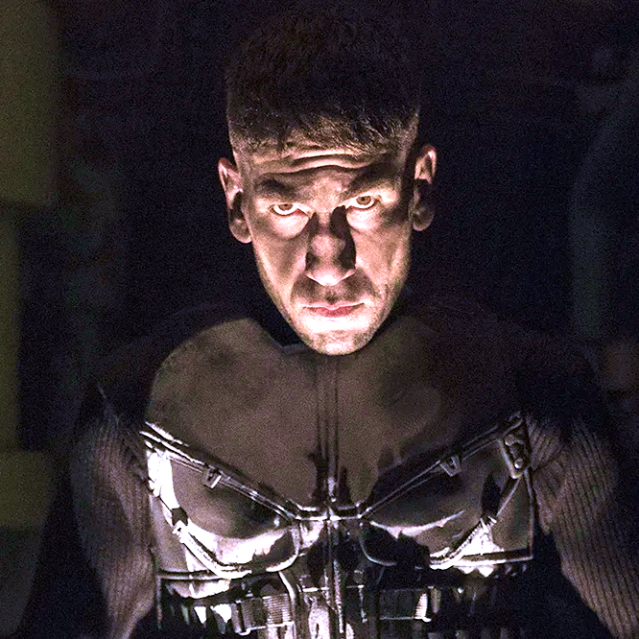
Design statement
The punisher needs to maintain a durable, healthy, robust, and clear-minded physical state, to ensure that he is more than capable of effectively eliminating those involved in malicious activities to reduce crime in New York City.

Slide 10
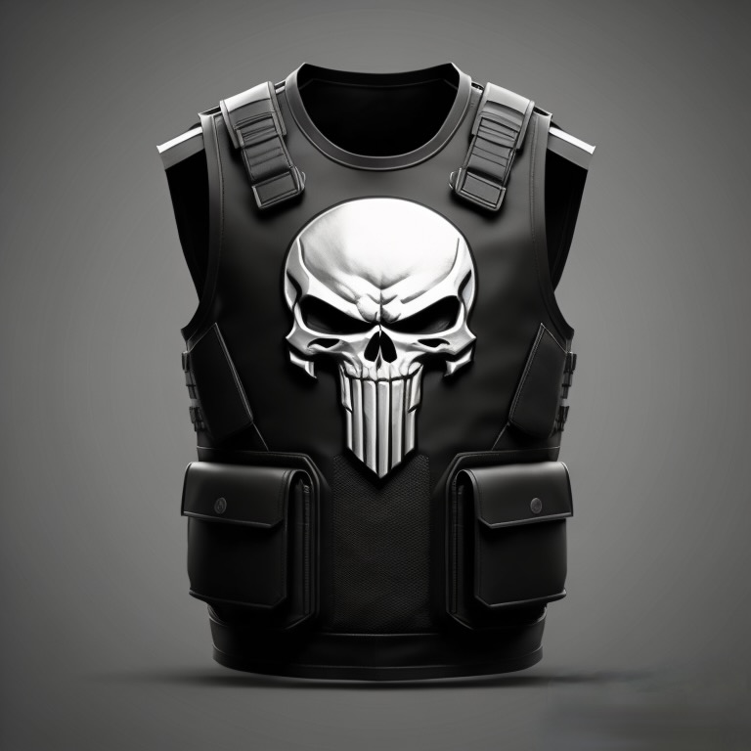
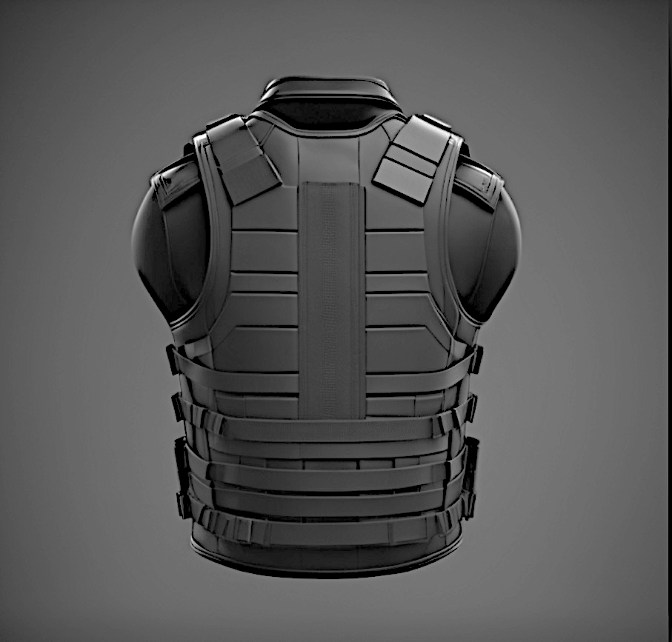
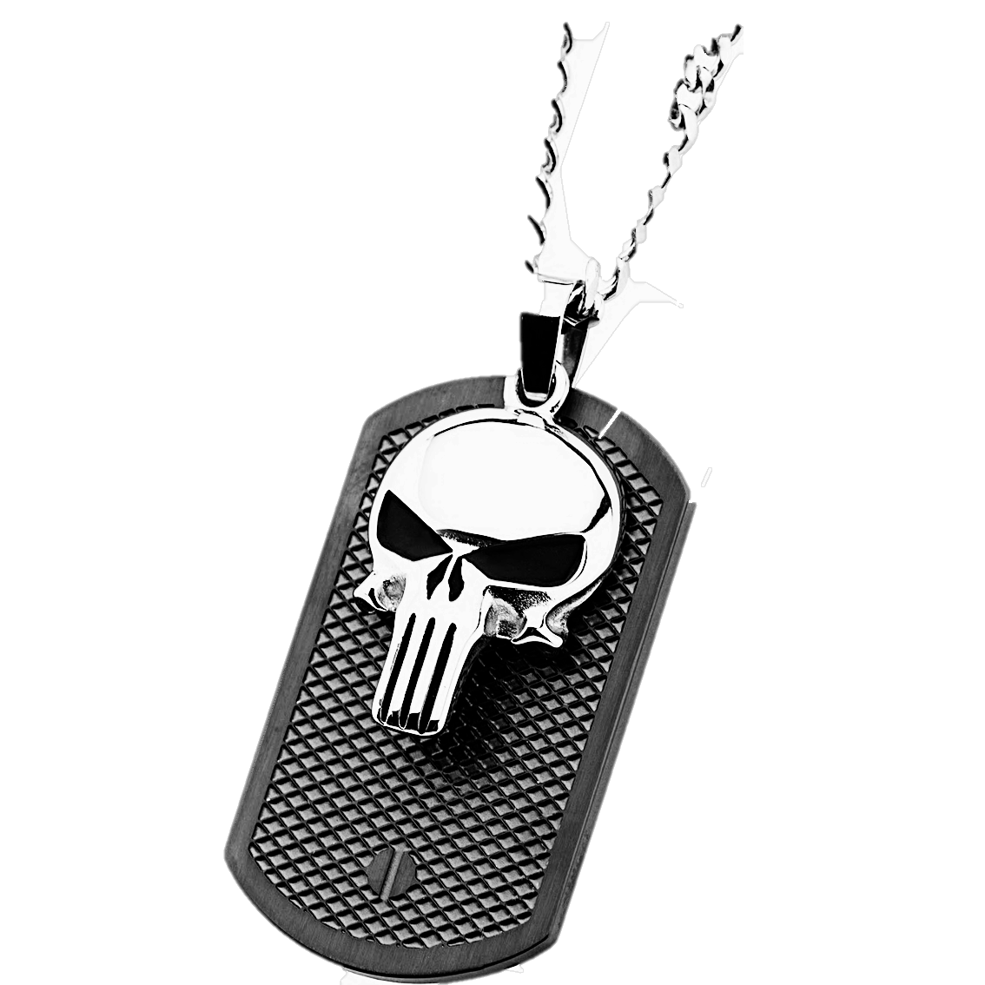
Final product design
The reward VEST

Slide 11
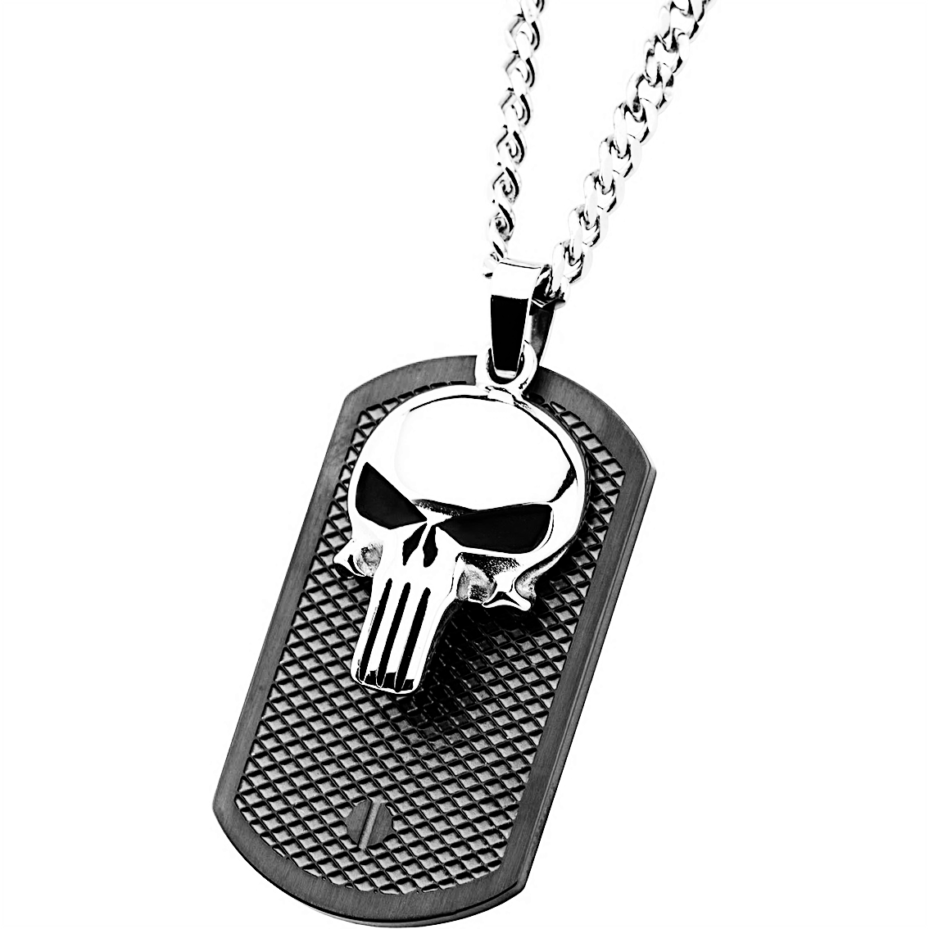
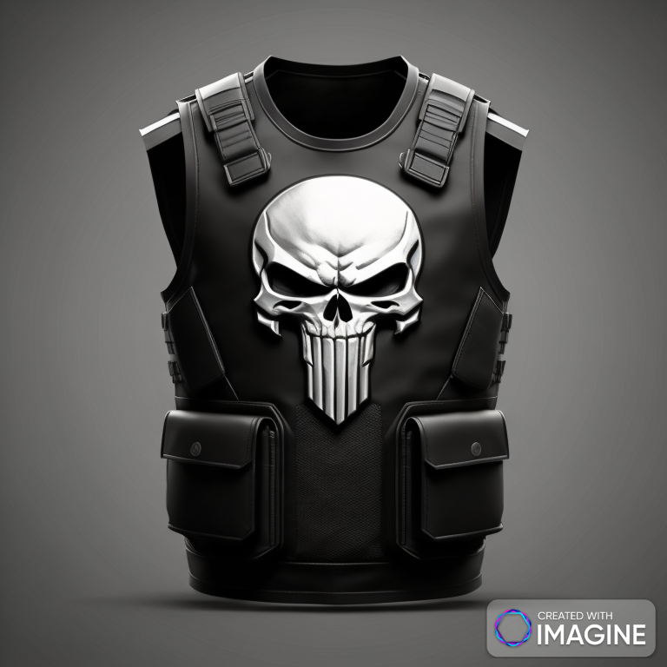
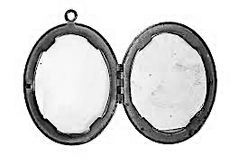
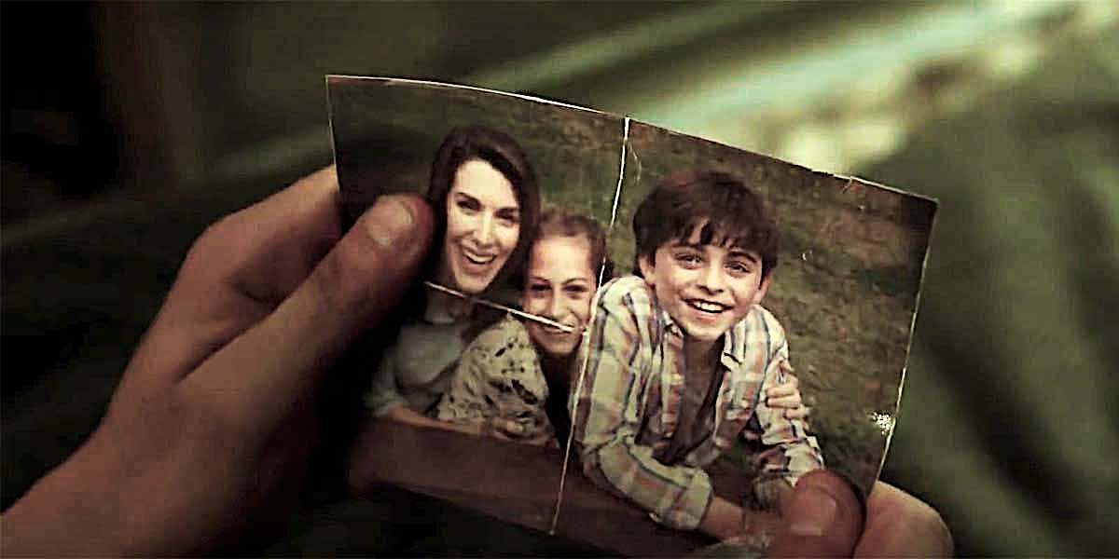
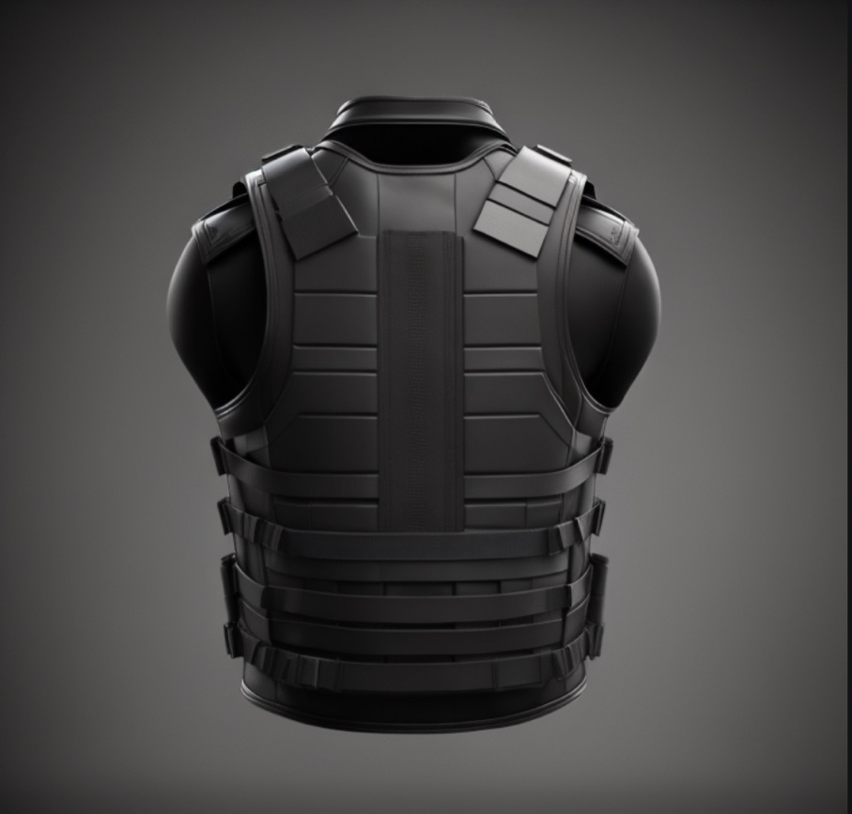





Design components and features
The initial product: a necklace that contains stark nanotech
Necklace is activated through a call to action (a thought or voice recognition)
Nanotech will take the form of the vest and encapsulate The Punisher’s torso; will also deploy an interface that attaches behind the ear allowing the ability to communicate with AI
Depending on call to action, the vest can appear under clothing or over clothing
Front of vest: made from indestructible material- Dyneema
The large skull symbol makes note of the body’s vital systems and will automatically act as a defibrillator if the heart stops
Has various tightly sealed pockets and compartments on the inside and outside of vest to store weapons
Straps on shoulders contain an Artificial intelligence system interface does what it is told
The necklace consists of:
A military dog tag- something he already wears frequently because of his past in the Marines; acts as a tracker
Skull pendant locket- opens up and contains a picture of his wife and children; sentimental value
Since his family is dead, a locket is a normal item to be wearing, unsuspecting to the enemy
Vest can be manually activated by pressing and holding the locket for 5 seconds
Nanotech from the pendant can also travel the whole surface area of his body and patch-up and clean cuts/ wounds/ blood/dirt from skin
Back of the vest: automatically supplies medication and neurotransmitters to the body when harm or damage is inflicted on the punisher
Activated either automatically by the nanotech, or by a call to action
Direct access to the spine
Protects neck

Slide 12
product abilities
Necklace as a whole- functions as the product that houses and deploys the nanotechnology to the different parts of the body (assembles the vest on the torso, places interface behind the ear for communication with AI, and deploys nanotech to scan and heal any wounds on the body)
Skull pendant- operates as a functioning locket, holds sentimental value, can manually activate the vest, represents the punishers trademark symbol
The front of the vest- contains the large skull symbol that can act as a defibrillator and keeps track of vitals; houses an AI interface on shoulder straps (capable of completing most tasks that are asked of it), has various secure and hidden pockets
The back of the vest- houses various medications and neurotransmitters and injects them directly into the spine when needed, then is either directed to the peripheral nervous system (limbs) or the central nervous system (spine and brain)
Adrenaline- helps the body respond to stress and danger
Serotonin- helps regulate mood, appetite, and sleep
Dopamine- promotes motivation, memory, attention, and regulation of body movements
Medications- opioids and non-steroidal anti-inflammatory drugs (nsaids), help manage pain and improve comfort. Hidden compartments-
Norepinephrine- promotes alertness and increased focus in stressful situations
Benzodiazepines- can be used to reduce anxiety and promote a sense of calm in highly stressful situations
Material of vest- made of dyneema, which is a high-performance synthetic fiber known for its exceptional strength, durability, and resistance to various environmental factors, known to be high-strength and lightweight

Slide 13
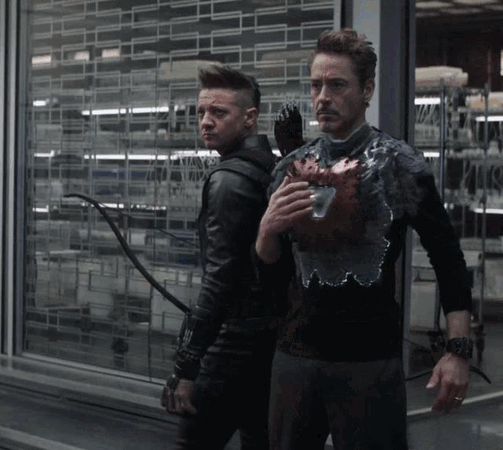
Inclusion of tech from the MCU
Tony Stark's nanotechnology is powered by nanites, which are extremely tiny, programmable particles that can self-assemble and disassemble to form various structures and materials
Stark created this technology and uses nanites in his Iron Man suits to generate the armor and weaponry in a steadfast efficient way
His thoughts or voice orders can regulate and reconfigure them. This enables the suit to be very adaptable, providing real-time defense, flight capabilities, and a variety of weaponry

Slide 14
What makes this a good product
It solves the punisher's problem of struggling with constantly being injured and in near-death situations, by offering various ways to aid and support him during combat. This is done in a simplistic user-centered way that follows his aesthetic appeal
The product also has systems in place to diminish the punisher's weaknesses and play off of his strengths

